Slide 1
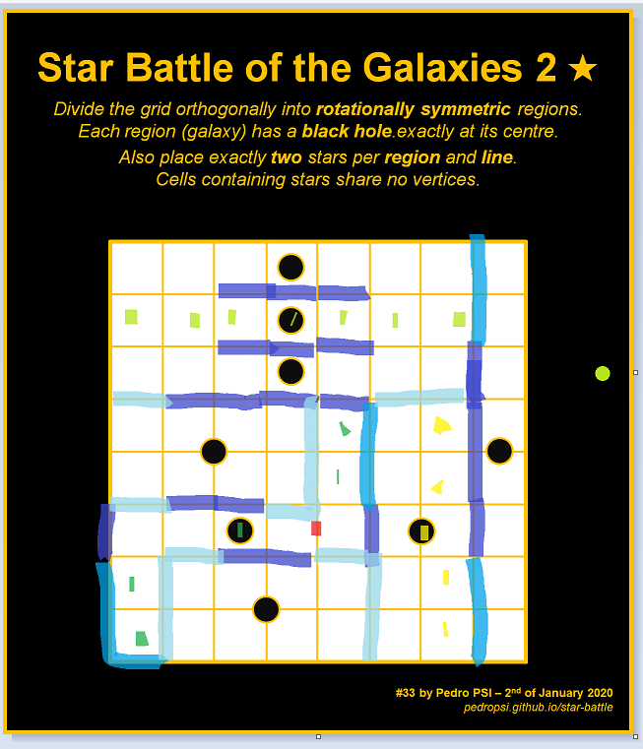
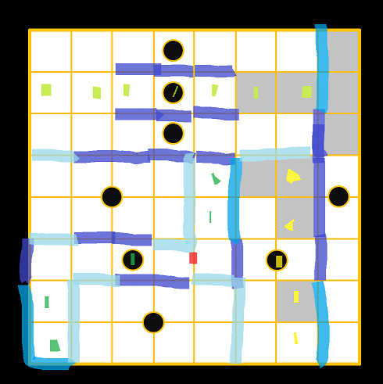
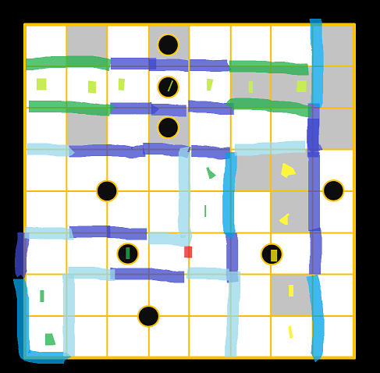
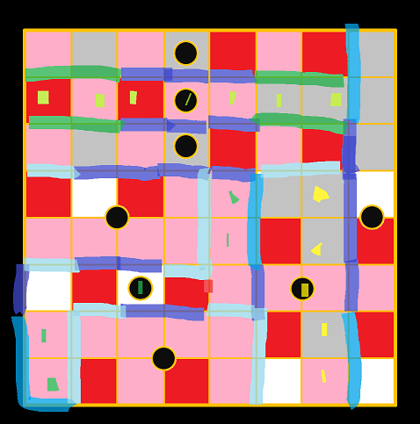
Star Battle of the Galaxies 2 ★
Divide the grid orthogonally into rotationally symmetric regions.
Each region (galaxy) has a black hole exactly at its centre.
Also place exactly two stars per region and line.
Cells containing stars share no vertices.
#33 by Pedro PSI – 6th of January 2020
pedropsi.github.io/star-battle

Slide 2
Star Battle of the Galaxies 2 ★
Divide the grid orthogonally into rotationally symmetric regions.
Every region is centered at a black hole.
Then place exactly two stars per region and line.
Cells containing stars share no vertices.
Stars and black holes may overlap.
#33 by Pedro PSI – 2nd of January 2020
pedropsi.github.io/star-battle

